Slide 1

B.Tech Project Final Evaluation, VIIIth Semester
Human Posture Estimation Using Different Deep Learning Techniques
Presented by :-
Satnam Singh - 2019001788
Nalin Kashyap - 2019005417
Viswajeet Kumar - 2019003633
Under the Supervision of:-
( Ms. Kanika Singla)
Sharda University, Gr. Noida
DEPARTMENT OF COMPUTER SCIENCE & ENGINEERING
SCHOOL OF ENGINEERING AND TECHNOLOGY

Slide 2

Approval from guide for the evaluation

Slide 3

Proof of outcome of 7th Semester

Slide 4
Contents of the Presentation:
S.no. | Title
1. | Workload Distribution and Project Planning
2. | Introduction to the project
3. | Objectives
4. | Application for the project
5. | Literature Survey
6. | Dataset
7. | Implementation Details
8. | Implementation Results
9. | Conclusion
10. | Gantt Chart

Slide 5
Workload distribution
Satnam Singh | Topic Selection and Information gathering, Paper Collection, Literature Survey, ResNet model implementation, Paper Writing
Nalin Kashyap | Topic Selection and Information gathering, ResNet model implementation, Tuning Models, Paper Writing
Viswajeet Kumar | Topic Selection and Information gathering, ResNet model implementation, Paper Writing
Table1. Workload distribution

Slide 6
Introduction to the Project
Human posture estimation is a crucial task in various fields such as human-computer interaction, rehabilitation, and health monitoring.
Accurate posture estimation can provide valuable information about an individual's movements and activities, which can be used for various applications such as motion tracking, gesture recognition, and fall detection.
In a continuation of previous resence we found that one of the most successful CNN architectures is ResNet. ResNet, short for Residual Network, uses residual connections, which allows the network to learn more complex functions. In traditional CNNs, the deeper layers of the network can struggle to learn useful features due to the vanishing gradients problem.
Residual connections allow the network to bypass this problem by allowing the gradients to flow directly through the layers. This enables ResNet to achieve exceptional performance on image classification tasks.

Slide 7
Objectives
In this research we will discuss the importance of human posture estimation and how it's been tackled in the past. We will also delve into the details of CNNs and ResNet and how they can be used for posture estimation. We will present our proposed method for posture estimation using multiple neural network architectures, and evaluate its performance using a dataset of human posture images. We will also compare our results with other existing methods and discuss the potential applications of our proposed approach.

Slide 8
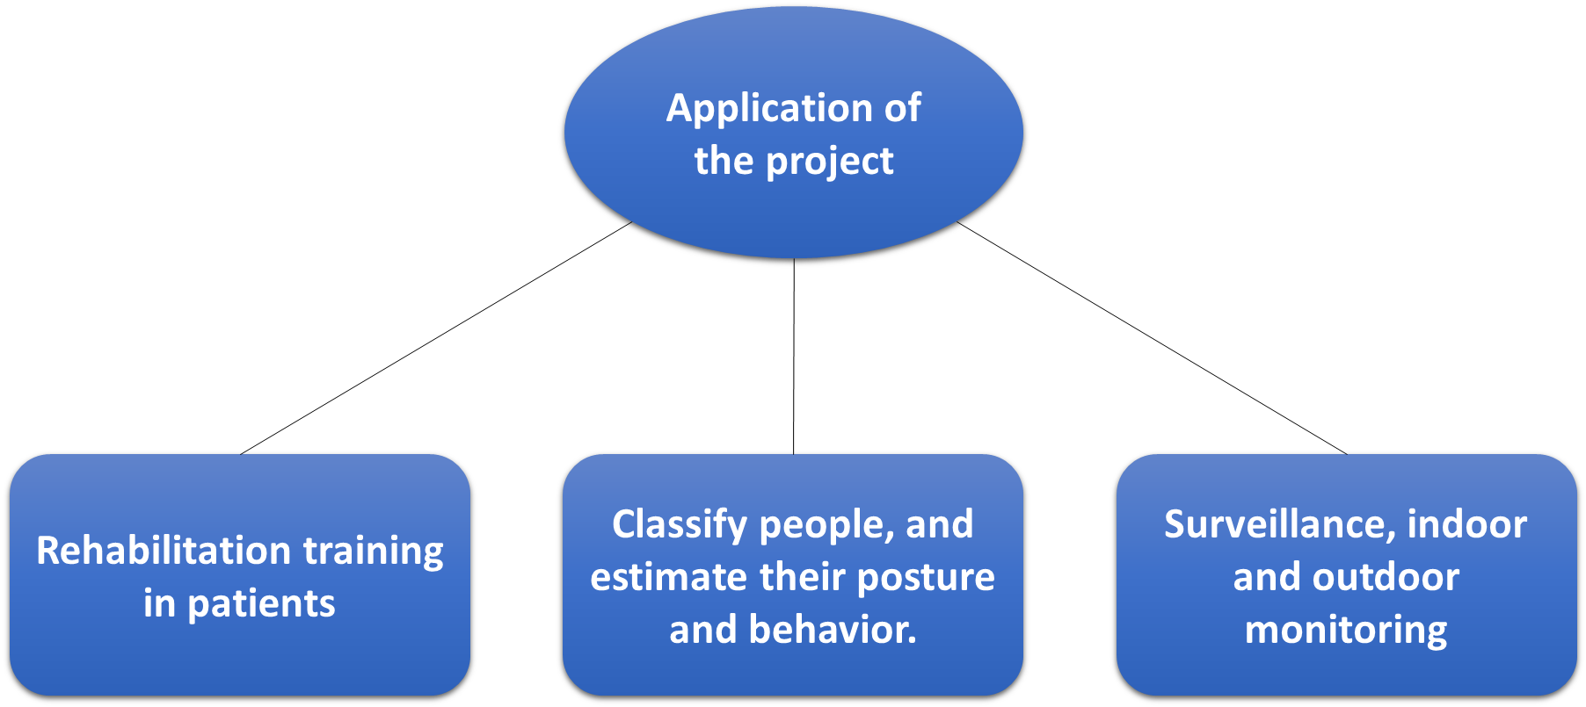
Application of the project
Fig1. Application of the project

Slide 9
Literature Survey
S.No | Name of Paper | Year | Authors | Objectives | Algorithm | Limitations | Outcome
1. | Human Posture Detection Using Image Augmentation and Hyperparameter-Optimized Transfer Learning Algorithms | 2022 | Roseline Oluwaseun, Ogundokun, Rytis Maskeliunas, Robertas Damasevicius | A new decision support framework for the optimization of hyperparameters for AlexNet, VGG16, CNN, and multilayer perceptron (MLP) models for accomplishing optimal classification results; | AlexNet, VGG16, CNN, and multilayer perceptron (MLP) | The disadvantage is the increased complexity, as finding optimal hyperparameter values requires additional computational resources. | This study used four models for decision support in posture recognition: two transfer learning algorithms and two deep learning algorithms CNN and MLP.y. AlextNet + HPO outperformed the other four models with a validation accuracy of 91.2% followed by VGG16 + HPO with a validation accuracy of 90.2%.

Slide 10
Literature Survey
S.No | Name of Paper | Year | Authors | Objectives | Algorithm | Limitations | Outcome
2. | Knowledge-Guided Deep Fractal Neural Networks for Human Pose Estimation | 2018 | Guanghan Ning, Zhi Zhang, Zhiquan He | Dependence between keypoints in human poses. In this work, we propose to explore how external knowledge can be effectively represented and injected into the deep neural networks to guide its training process using learned projections that impose proper prior. Specifically, we use the stacked hourglass design and inception-resnet module to construct a fractal network to regress human pose images into heatmaps with no explicit graphical modeling. | Inception-resnet Modules, Fractal Networks, Knowledge-Guided Learning. | the deep neural network, which is inherently an algebraic computation system, is not the most effecient way to capture highly sophisticated human knowledge, for example those highly coupled geometric characteristics and interdependence between keypoints in human poses. | In this work, we proposed to encode and inject external human knowledge into deep neural networks to guide its training process with learned projections for more effective human pose estimation.

Slide 11
Literature Survey
S.No | Name of Paper | Year | Authors | Objectives | Algorithm | Limitations | Outcome
3. | Human Pose Estimation via Improved resnet 50 | 2017 | Xiao Xiao, Wanggen Wan | It will provide a method to predict 2D human pose estimation is formulated as a regression problem towards body joints top-down methods | ResNet-50 | In this work we use datasets which have large number of training eamples sufficient to train a large model as well as are realistic and challenging. | We Present our knowledge, the first application of ResNet-50 to human posture estimation.As a result, we are able to achieve state-of-the-art or better results on several challenging academic datasets.

Slide 12
Literature Survey
S.No | Name of Paper | Year | Authors | Objectives | Algorithm | Limitations | Outcome
4. | Structure-aware human pose estimation with graph convolutional network | 2020 | Yanrui Bina , Zhao-Min Chenb , Xiu-Shen Wei c, Xinya Chena , Changxin Gaoa , Nong Sang | The model builds a directed graph between body key points according to the natural compositional model of a human body. Each node (key point) is represented by a 3-D tensor consisting of multiple feature maps. | CNN, ResNet | In this work we use datasets which have large number of training eamples sufficient to train a large model as well as are realistic and challenging. | The primary challenge for pose estimation is to capture organised relationships between important human body locations and also visualizes some heat maps produced by the ResNet-50 baseline model, ResNet-50 + L-PGCN model and ground-truth.

Slide 13
Literature Survey
S.No | Name of Paper | Year | Authors | Objectives | Algorithm | Limitations | Outcome
5. | A Novel Deep Transfer Learning Approach Based on Depth-Wise Separable CNN for Human Posture Detection | 2022 | Roseline Oluwaseun Ogundokun , Rytis Maskeliunas , Sanjay Misra, Robertas Damasevicius | The model tends to provide a strong increase in accuracy with an increasing number of epochs, without showing any signs of performance problems or overfitting. The approach also performs well in classification and detection exhibitions, with reasonable computation costs and a significantly smaller number of parameters. | DenseNet-121, ResNet-50V2, DeneSVM | With reasonable computation costs and a significantly smaller number of parameters. | DenseNet-121 achieves a accuracy of 92%, while ResNet-50V2 achieves a accuracy of 93% and finally DeneSVM achieves a test accuracy score of 94.72% for the 30th epoch, and a test accuracy of 95%.

Slide 14
Literature Survey
S.No | Name of Paper | Year | Authors | Objectives | Algorithm | Limitations | Outcome
6. | Deep Residual Learning for Image Recognition | 2015 | KaimaingHe, Xiangyu Zhang, Shaoqing Ten, Jin Sun | The Objective of this paper is Object Detection on PASCAL and MS COCO with different algorithms. | Residual Networks, ResNet-50 | Deeper neural networks are more difficult to train. It will take high system requirement and time. | The improvements can only be ascribed to improved networks since both models' detection implementations (see appendix) are the same.The most remarkable result is a 6.0% rise in COCO's standard measure, which is a 28% relative improvement on the tough COCO dataset.
Table 2. Literature Survey

Slide 15
Dataset
The data set has been consolidated for the task of Human Posture Recognition.Here we are going to use IEEE dataset which is the latest dataset publicly available for human posture recognition. In total we obtained 4800 images which are categorised in four postures.
Sitting,
Standing,
Bending and,
Lying.
For each of the postures listed above contains 1200 images. The images have a dimension of 512 x 512 px.So we can increase our potential to predict different postures with the help of this dataset.

Slide 16
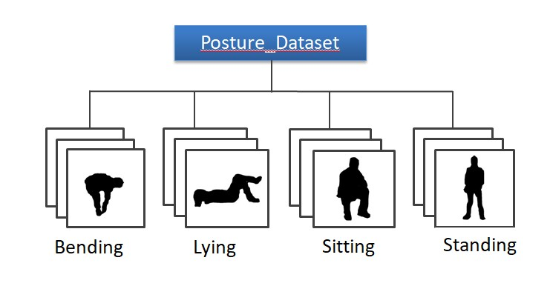
Dataset
{
1,200
Fig 2. Dataset
(https://ieee-dataport.org/open-access/silhouettes-human-posture-recognition)

Slide 17
Implementation Details (ResNet)
Model defined in the code uses the ResNet Version 1 architecture with 20 layers, Resnet-18 and Resnet -34.
ResNet is a deep convolutional neural network architecture.
It was developed by Microsoft Research and won the first place in the ImageNet Large Scale Visual Recognition Challenge (ILSVRC) in 2015.
It is widely used in image classification tasks and is known for its ability to effectively reduce the problem of vanishing gradients during training, which is a common issue in deep neural networks.
The architecture of ResNet includes several residual blocks, which are designed to facilitate the flow of information through the network and improve its performance.

Slide 18
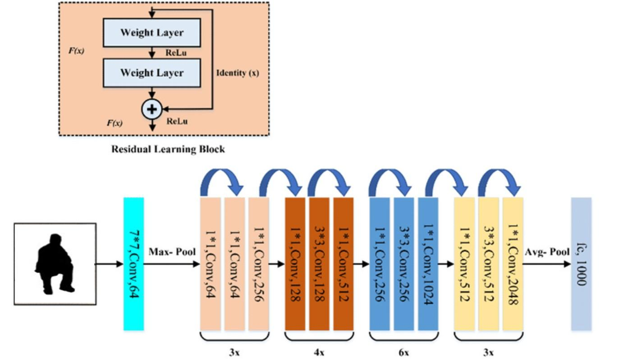
Implementation Details (ResNet)
Fig 3. Resnet Architecture

Slide 19
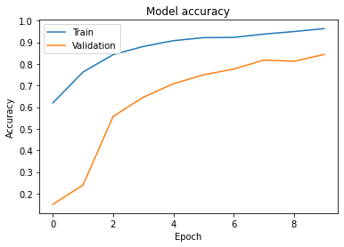
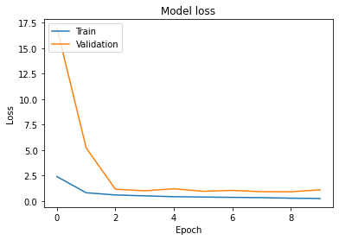
Implementation Results (ResNet)
Fig. 4 ResNet V-1

Slide 20
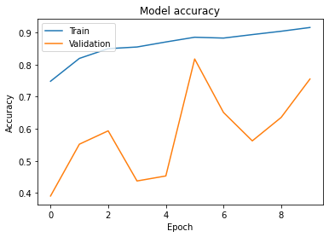
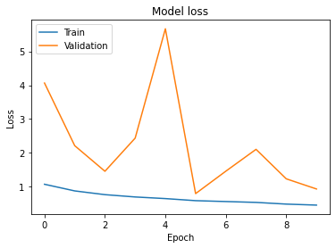
Implementation Results (ResNet)
Fig. 5 ResNet 18

Slide 21
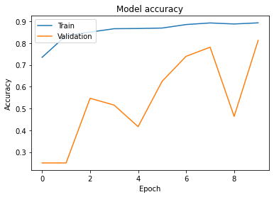
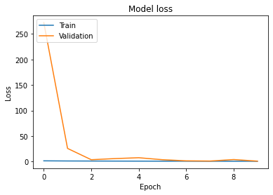
Implementation Results (ResNet)
Fig. 6 ResNet 34

Slide 22
Implementation Results (ResNet)
Model | Training loss | Training accuracy | Val loss | Val accuracy
Resnet V-1 | 24.80% | 96.31% | 1.1022 | 84.38%
Resnet -18 | 45.43% | 91.58% | 0.9322 | 75.52%
Resnet -34 | 61.38% | 89.32% | 0.9038 | 81.25%
Table 3. ResNet Comparison Summary Table

Slide 23
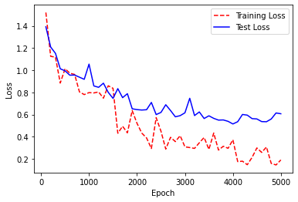
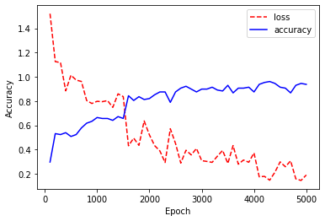
Implementation Results (CNN )
Fig. 7 16 neurons with 4 layers

Slide 24
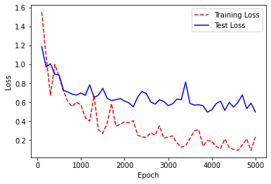
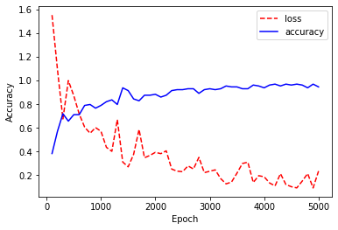
Implementation Results (CNN )
Fig. 8 32 neurons with 4 layers

Slide 25
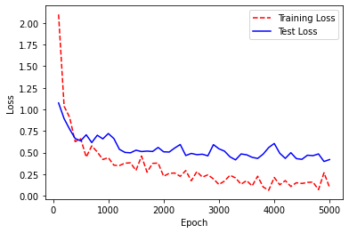
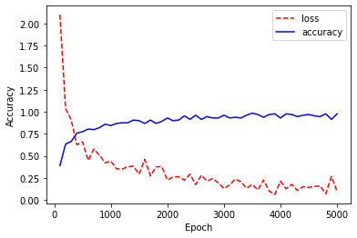
Implementation Results (CNN )
Fig. 9 64 neurons with 4 layers

Slide 26
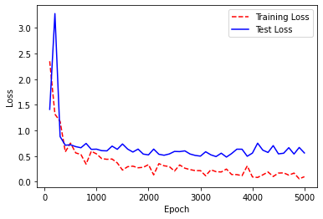
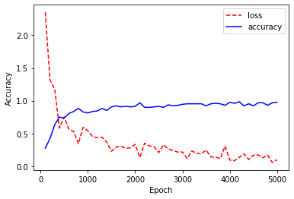
Implementation Results (CNN )
Fig. 10 128 neurons with 4 layers

Slide 27
Implementation Results (CNN )
Layers & Neurons | Training loss | Training accuracy | Val loss | Val accuracy
4 & 16 | 19.04% | 93% | 60.69% | 81.88%
4 & 32 | 23.46% | 94% | 49.67% | 83.85%
4 & 64 | 9.62% | 97.66% | 40.93% | 85.94%
4 & 128 | 9.62% | 97% | 41.93% | 85.94%
Table 4. CNN Comparison Summary Table

Slide 28
Conclusion
The Results while performing the analysis shows that CNN works better than ResNet as the CNN model gives the highest accuracy of 97.66% when 4 layers with 64 Neurons were implemented.
While in case of Resnet the base version of ResNet with 20 layers performs best with accuracy of 96.31%

Slide 29
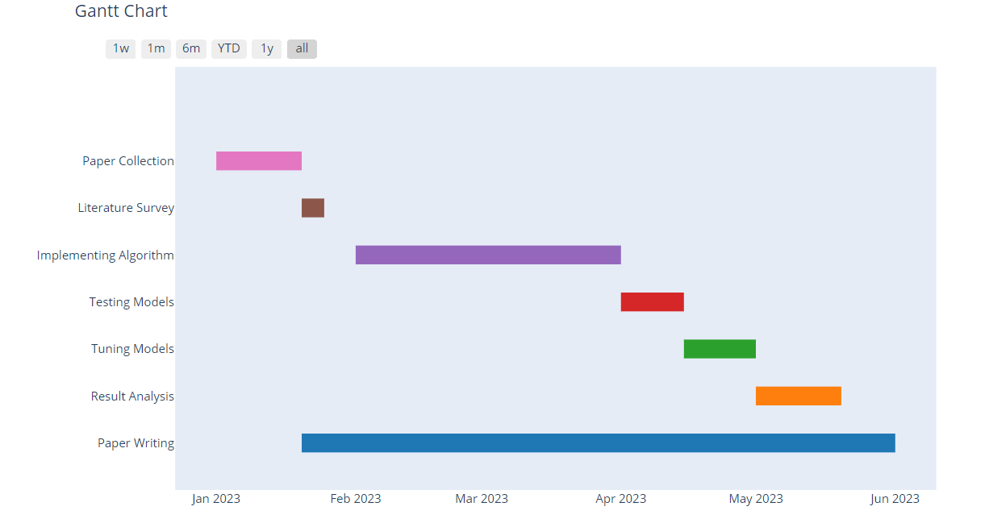
Project planning and work schedule (Gantt-Chart)
Fig 4.Gantt-Chart

Slide 30
THANK YOU!!

